Slide 1


ESP-Mesh
Workshop
29 September 2023

Slide 2


About Me

Slide 3
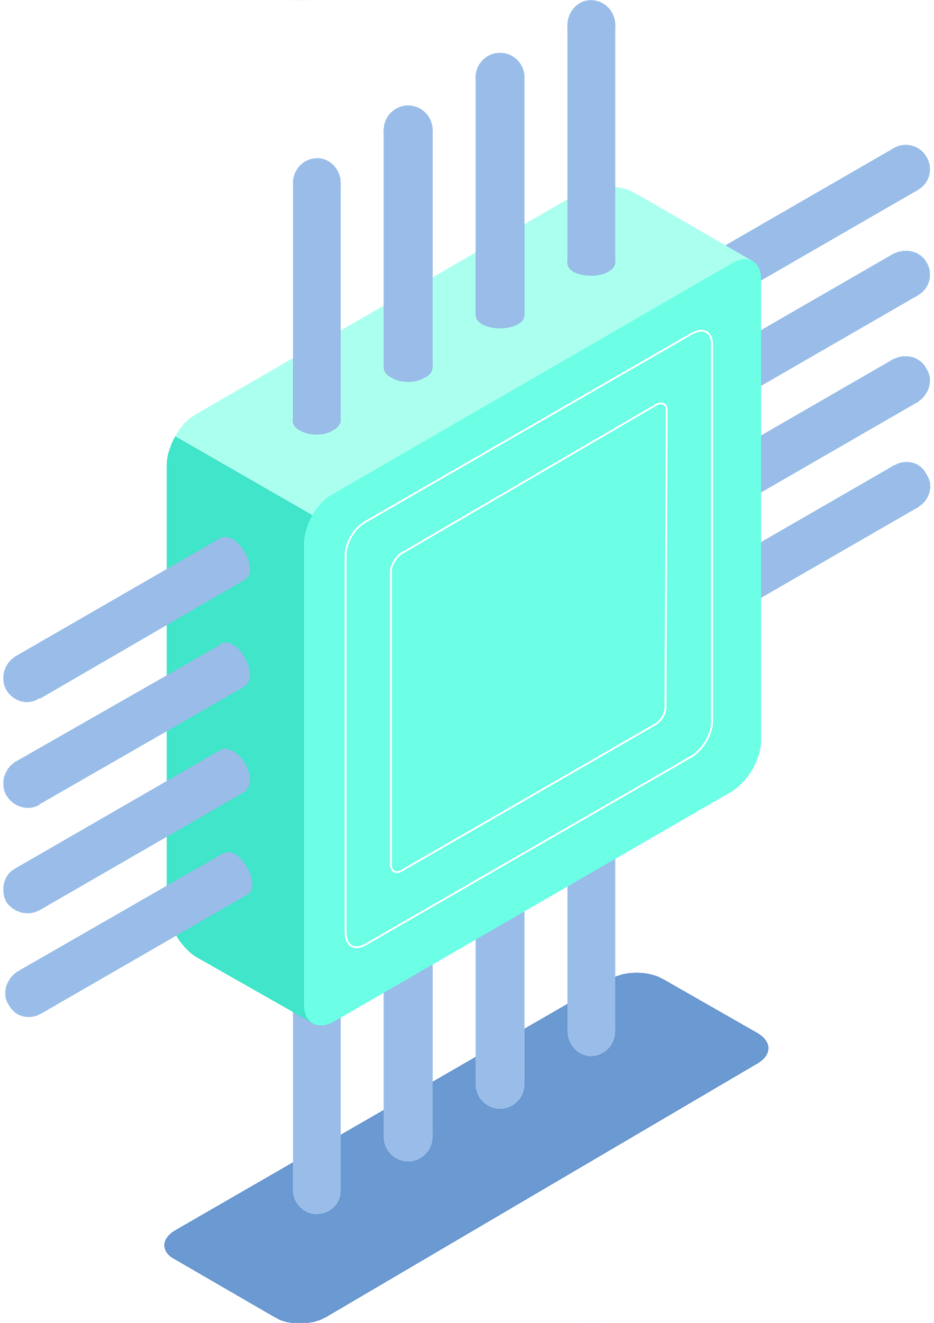
Introduction to ESP32 Board
1

Slide 4

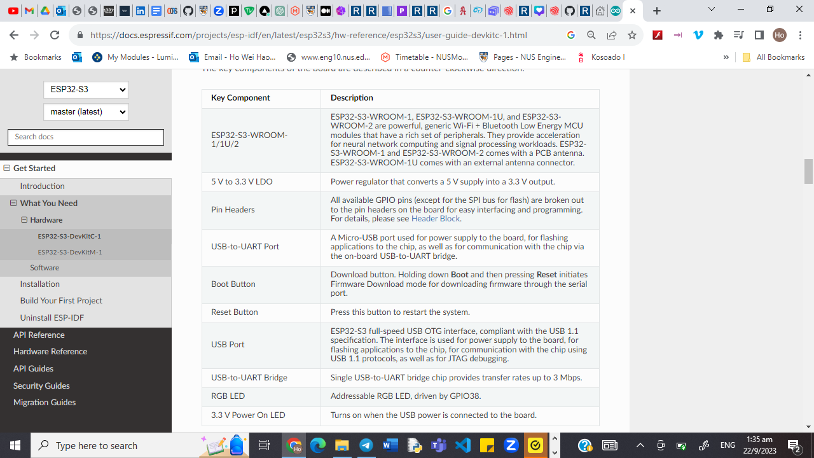
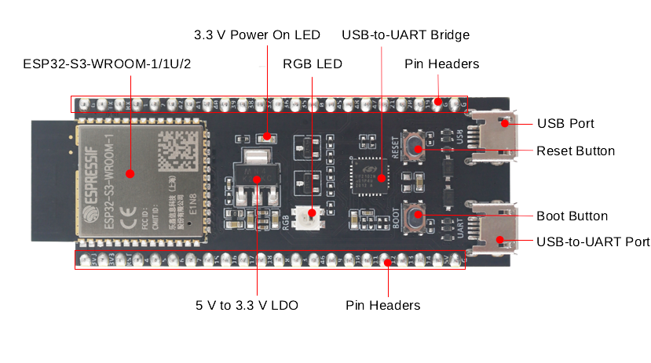
ESP32-S3-DevKitC-1 Board
https://docs.espressif.com/projects/esp-idf/en/latest/esp32s3/hw-reference/esp32s3/user-guide-devkitc-1.html

Slide 5
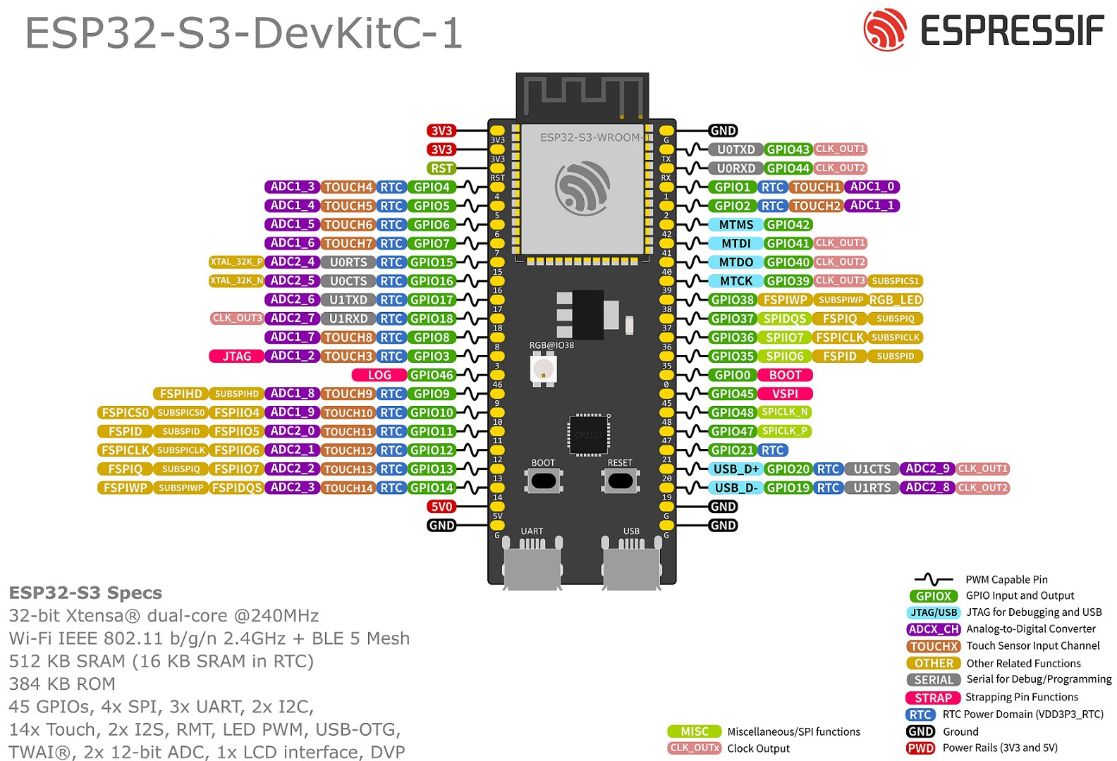
https://docs.espressif.com/projects/esp-idf/en/latest/esp32s3/hw-reference/esp32s3/user-guide-devkitc-1.html

Slide 6
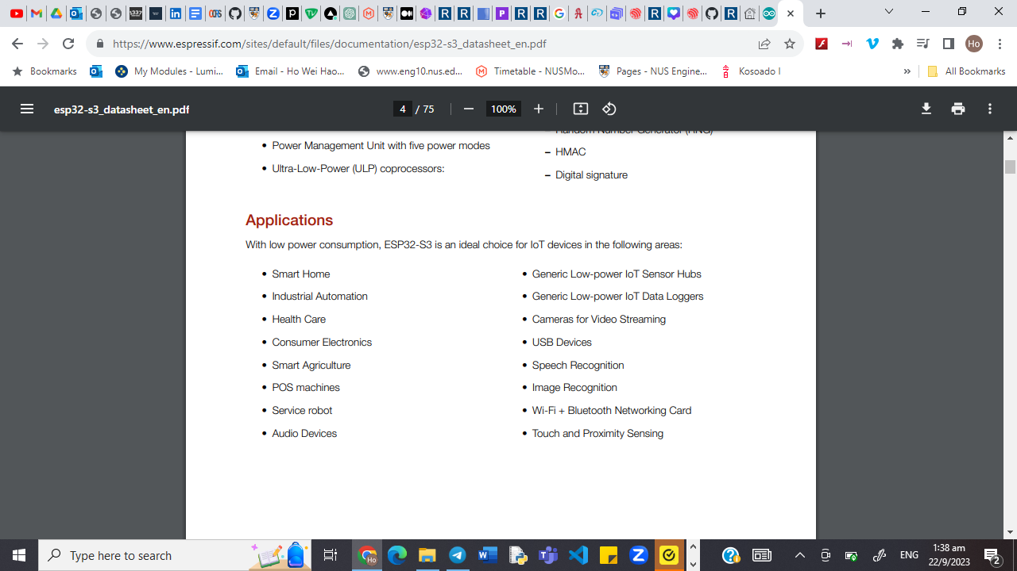
ESP32-S3-DevKitC-1 Board

Slide 7

Introduction to Arduino IDE
2

Slide 8

Arduino IDE
Download IDE from https://www.arduino.cc/en/software
Easily download libraries to use
Flexibility in managing many different boards

Slide 9
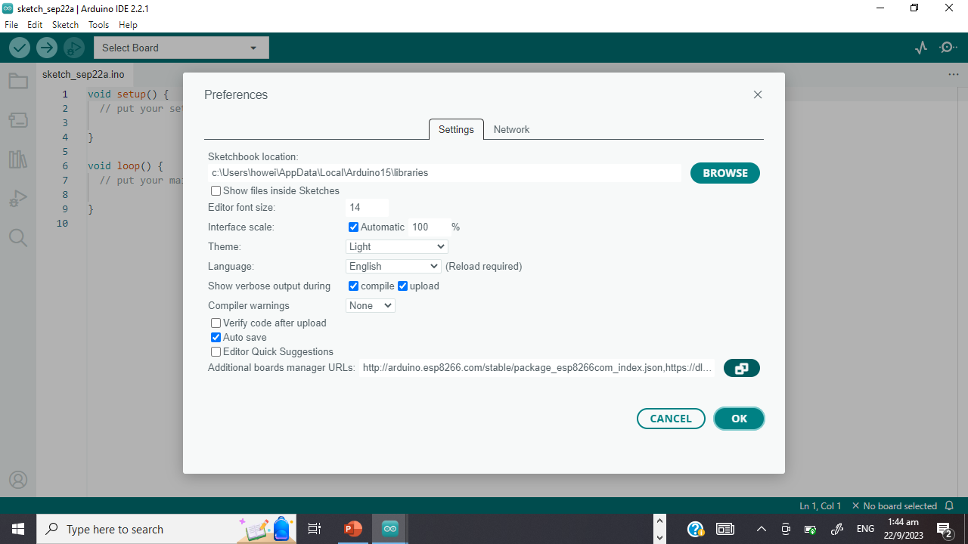

Getting Started
Start up Arduino IDE
Go to Arduino
IDE > Preferences > Additional Boards Manager URLs
and paste the JSON link
https://raw.githubusercontent.com/espressif/arduino-esp32/gh-pages/package_esp32_dev_index.json
https://hutscape.com/tutorials/hello-arduino-esp32s3

Slide 10
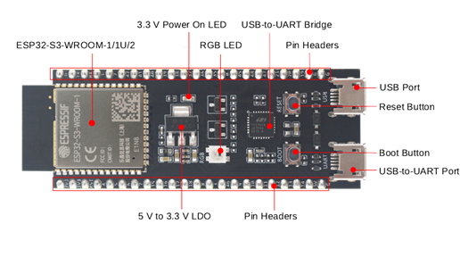
How to Connect to the Board?

Slide 11
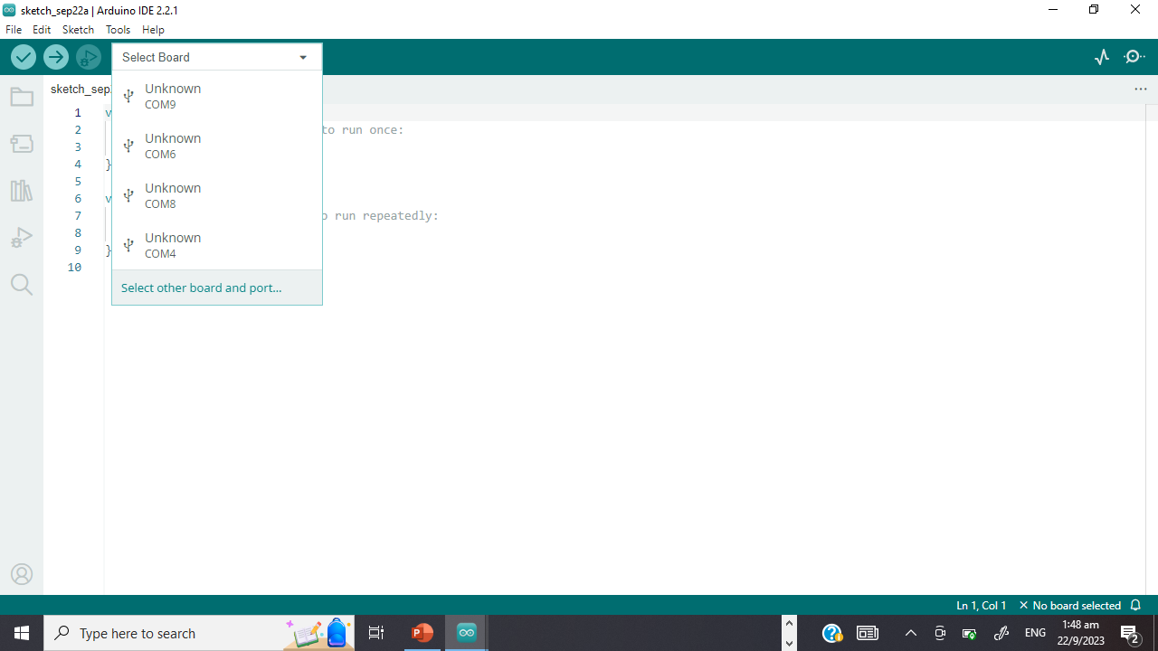
Getting Started
After downloading, connect the board to the UART port (right port)
Select board > other board and port
Choose the board “ESP32-S3-USB-OTG”

Slide 12
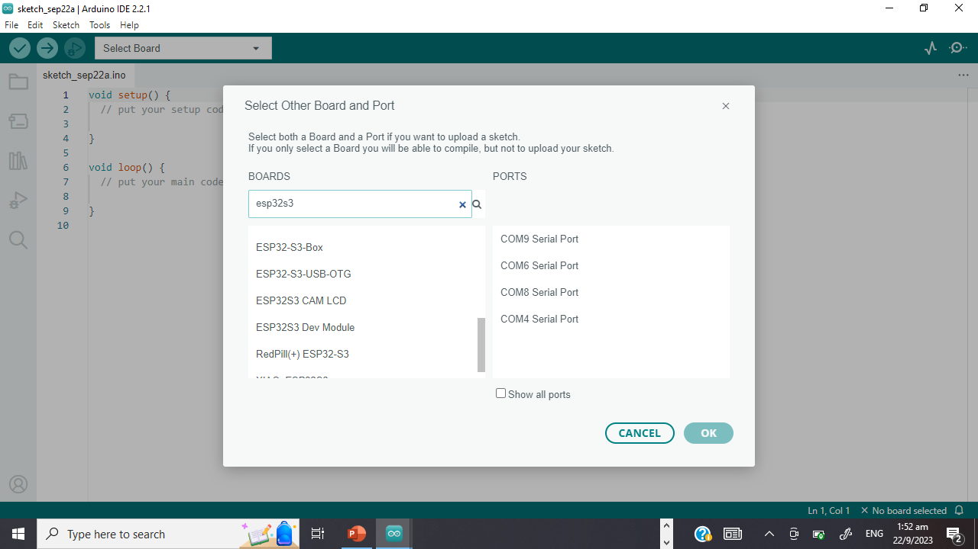
Getting Started
After downloading, connect the board to the UART port (right port)
Select board > other board and port
Choose the board “ESP32-S3-USB-OTG”

Slide 13

3
Traditional ESP Connection

Slide 14
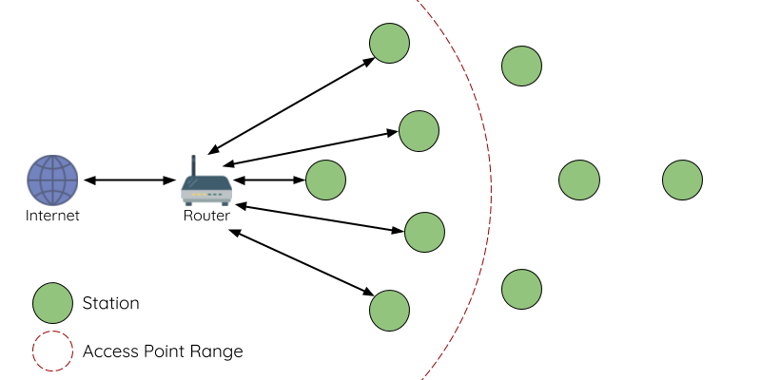
Traditional

Slide 15
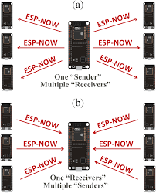
Example: ESP-NOW
“Star” shape
One master, multiple slaves
Without Wifi

Slide 16
Let’s Try It Out!
Flash the now_sender code
https://randomnerdtutorials.com/esp-mesh-esp32-esp8266-painlessmesh/

Slide 17
Try removing one device!
https://randomnerdtutorials.com/esp-mesh-esp32-esp8266-painlessmesh/

Slide 18

4
ESP-Wifi-Mesh

Slide 19
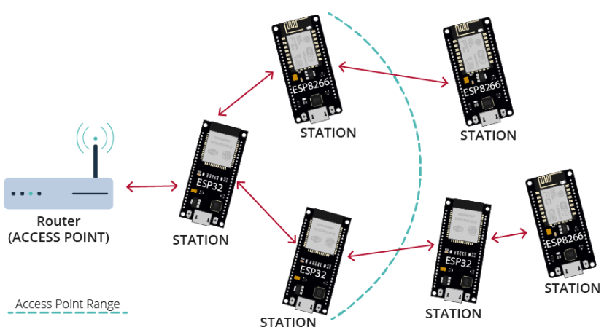
Mesh
https://randomnerdtutorials.com/esp-mesh-esp32-esp8266-painlessmesh/

Slide 20





Why ESP-Mesh?
Self-organizing
Self-healing
Potentially unlimited device pairing
Do not require additional mesh infrastructure to cover wider areas
IP connectivity, access provided by node

Slide 21
Let’s Try It Out!

Slide 22
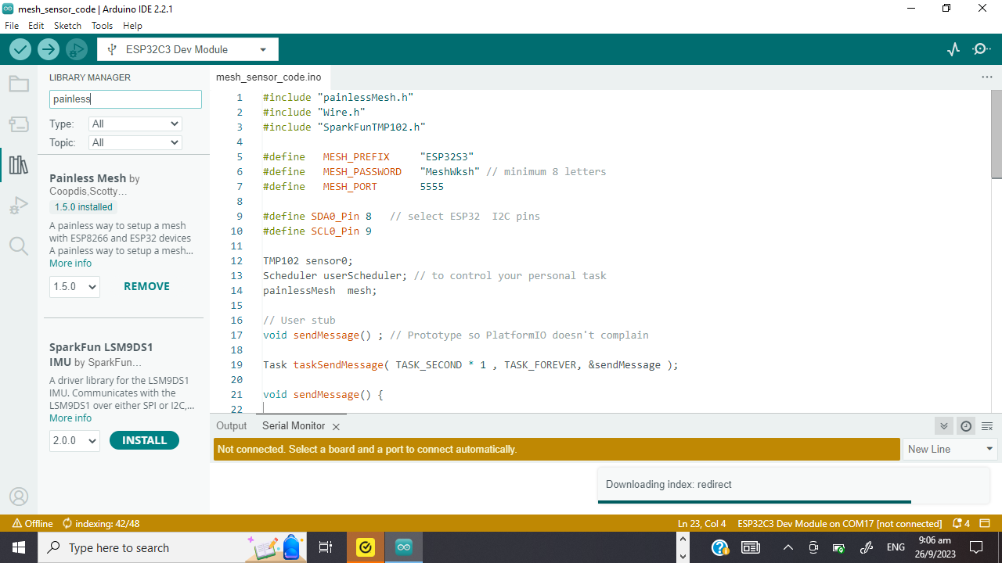
Required Libraries
Painless Mesh
Additional libraries
ArduinoJson (by bblanchon)
TaskScheduler
ESPAsyncTCP (ESP8266)
AsyncTCP (ESP32)

Slide 23
Let’s Try It Out!
Flash the mesh_basic_code
https://randomnerdtutorials.com/esp-mesh-esp32-esp8266-painlessmesh/

Slide 24
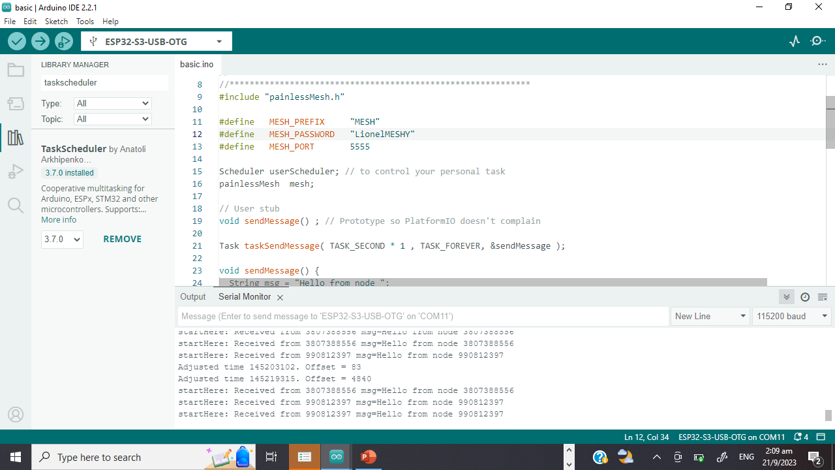
Expected Outcome (Connected)
Boards receive messages from each other
Adjustments in receival time (self-healing)

Slide 25
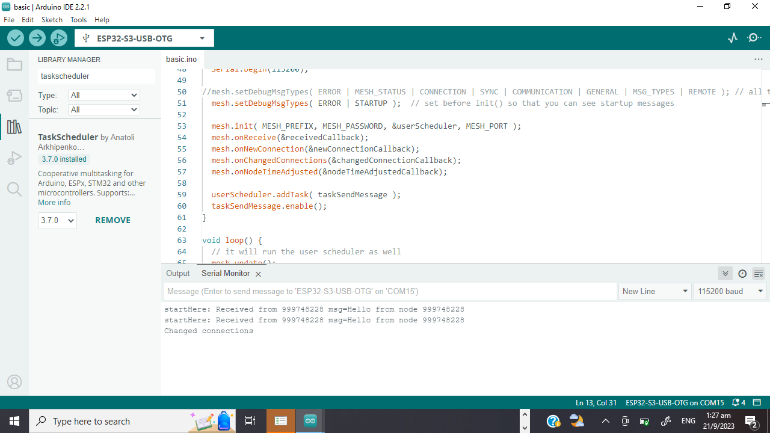
Expected Outcome (Disconnected)
Change connection
Root node selection

Slide 26

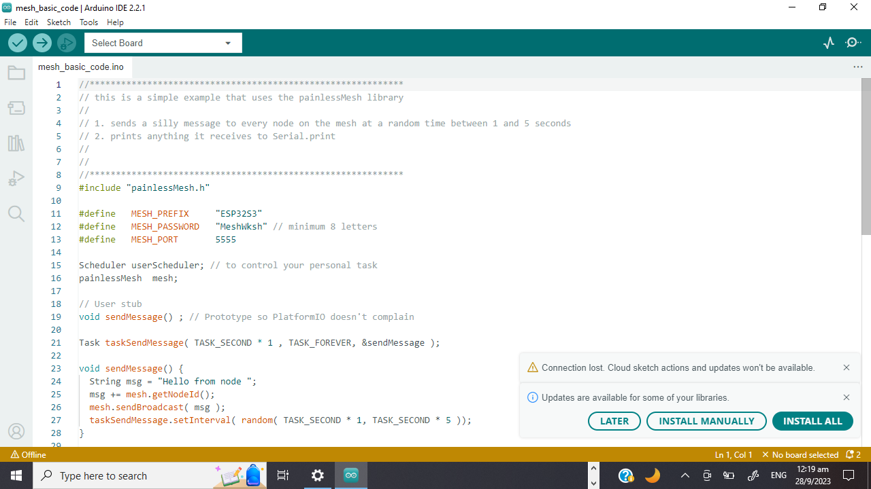
Code Inspection
“Username” and “password”
Can be altered to your choice

Slide 27
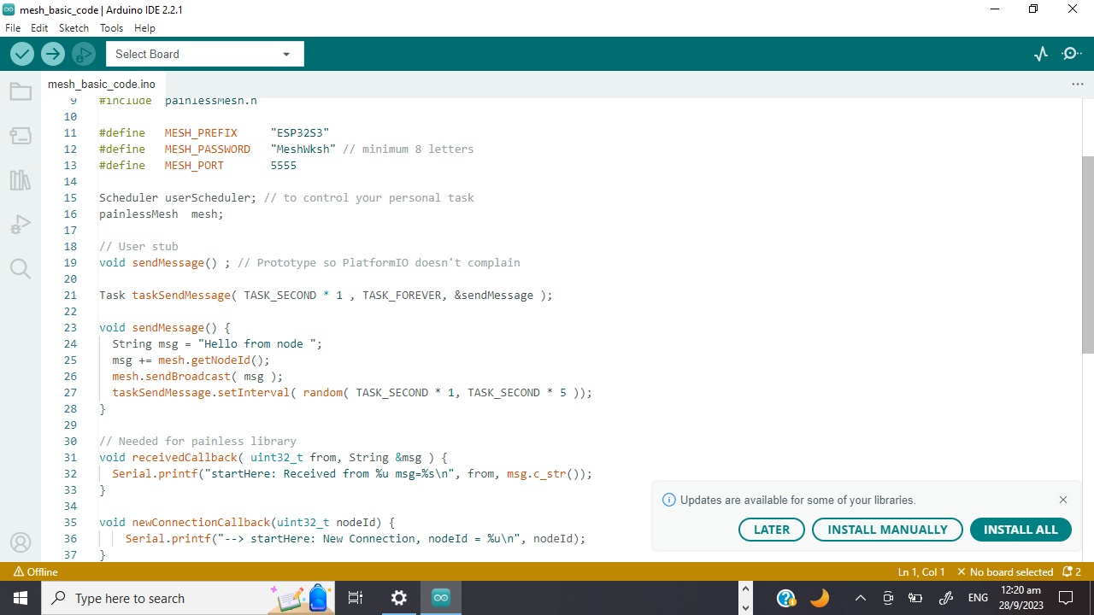
Code Inspection
Recommended to avoid using delay() in the mesh network code.
Delay() will stop background tasks and can cause the mesh to lose stability/fall apart.

Slide 28
Code Inspection
Constructs and sends a message
Queries for chip ID
Choose random time interval to send another message

Slide 29
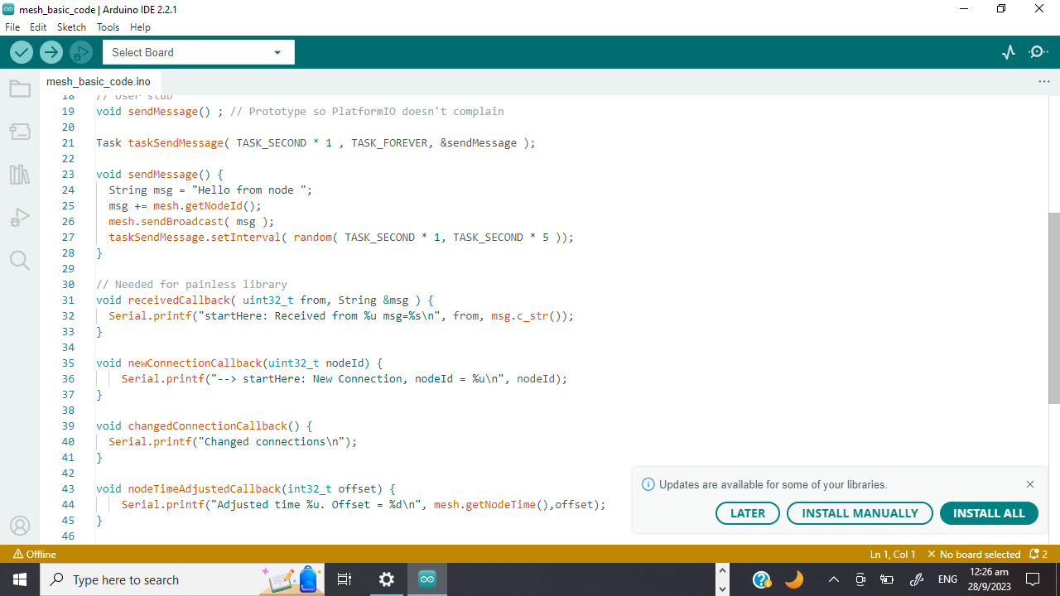
Code Inspection
Checks for any message received
Prints message

Slide 30
Code Inspection
Runs when a new node joins
Potential for other functionality

Slide 31
Code Inspection
Runs when a node joins or leaves
Potential for other functionality

Slide 32
Code Inspection
Runs when network adjusts time to synchronise all nodes

Slide 33
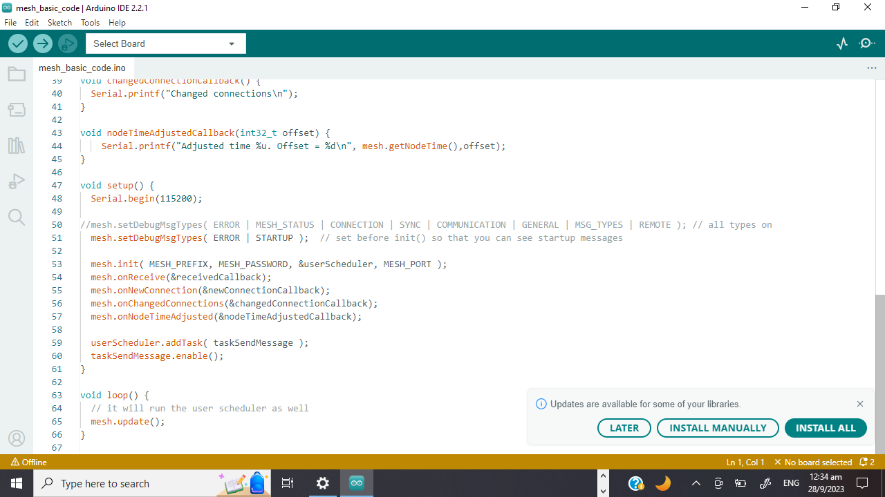
Code Inspection
Set error message type
Initialise mesh
Assign callback functions to corresponding events
Add tasks to scheduler which keep tracks of the time

Slide 34
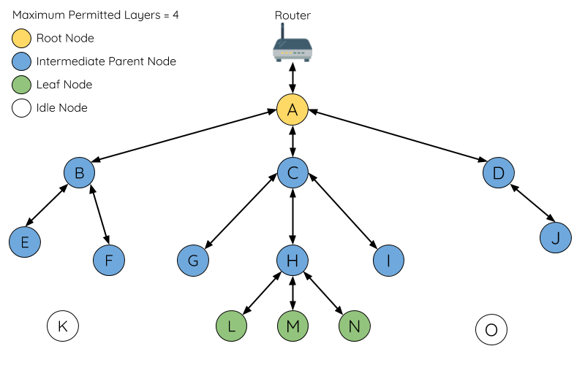
ESP-Mesh Topology

Slide 35

Forming the Mesh
Every node periodically transmits Wi-Fi beacon frames
Idle nodes listen for beacon frames to generate a list of potential parent nodes,
If a beacon frame with an RSSI is below a preconfigured threshold, the transmitting node will be disregarded when forming an upstream connection.
https://docs.espressif.com/projects/esp-idf/en/stable/esp32/api-guides/esp-wifi-mesh.html

Slide 36
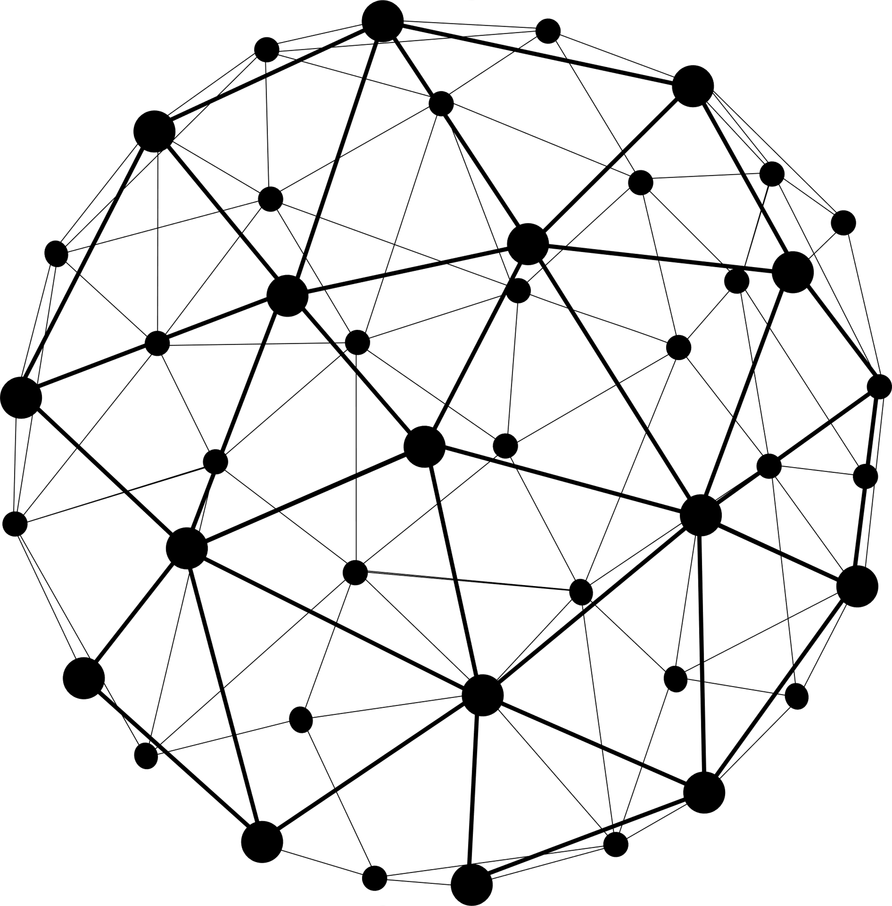
Forming the Mesh
Idle node will form an upstream connection with the preferred parent node.
Determined based on (1) parent node layer and (2) number of child nodes
https://docs.espressif.com/projects/esp-idf/en/stable/esp32/api-guides/esp-wifi-mesh.html

Slide 37

Root Node Selection (Election Process)
Scans for beacon frames from other nodes.
Votes for nodes with a beacon frame with a stronger router RSSI
Individually check for its vote percentage
If a node has a vote percentage larger than a preconfigured threshold (90% by default), the node will become a root node.
https://docs.espressif.com/projects/esp-idf/en/stable/esp32/api-guides/esp-wifi-mesh.html

Slide 38

Network Management
Root Node Failure
Intermediate Parent Node Failure
Root Node Switching
Parent Node Switching
https://docs.espressif.com/projects/esp-idf/en/stable/esp32/api-guides/esp-wifi-mesh.html

Slide 39
5
APPLICATIONS
You could enter a subtitle here if you need it

Slide 40
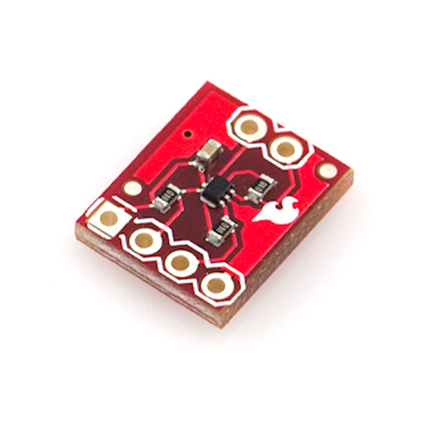
Temperature Monitoring Project
TMP102 breakout board
Input 3V3
Supports I2C

Slide 41
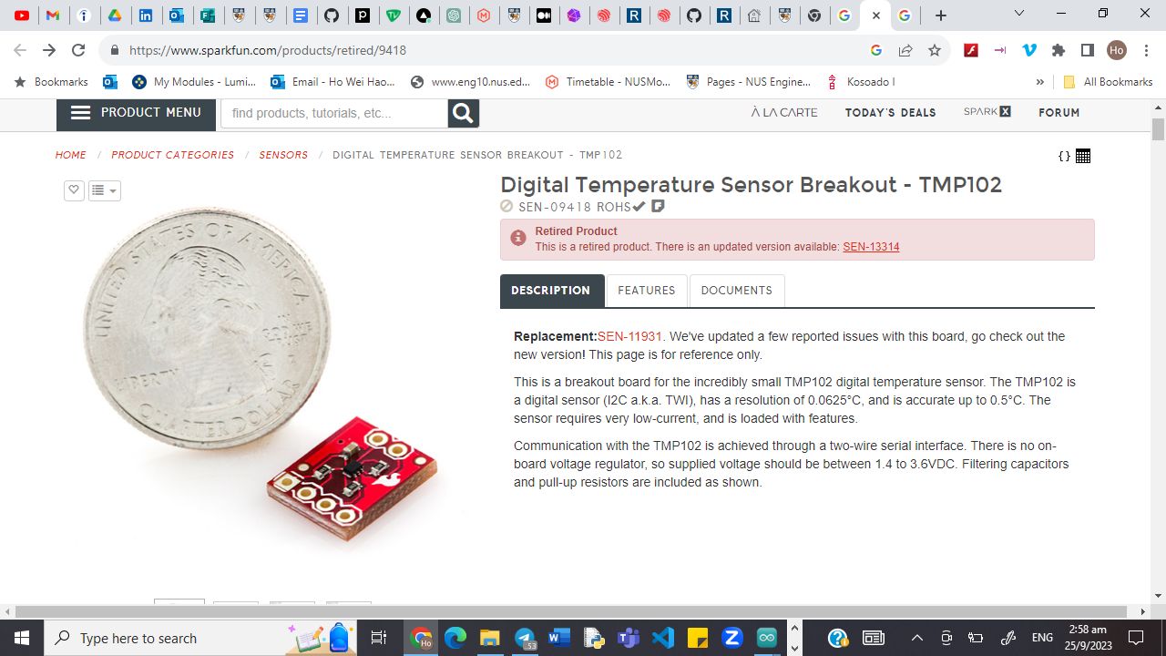

Slide 42
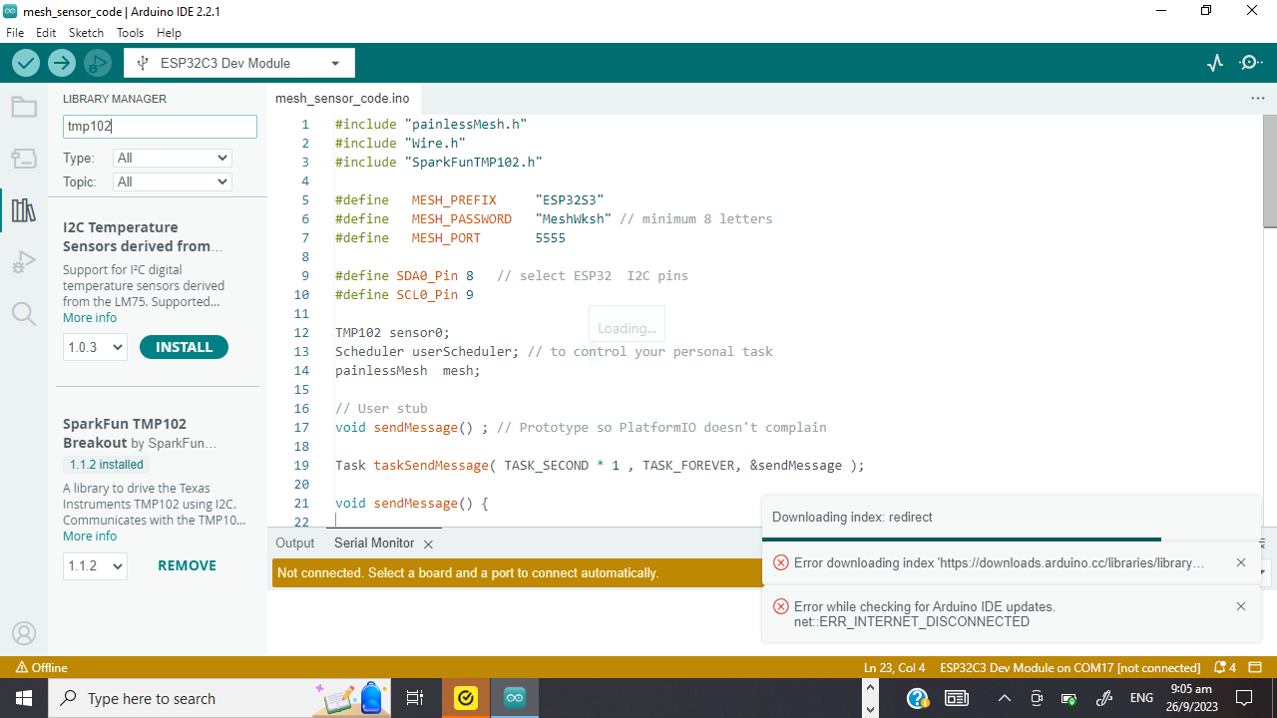
Libraries
SparkFun TMP102 Breakout
To read sensor data

Slide 43
Let’s Try It Out!
Connect the esp32 to the sensor
https://randomnerdtutorials.com/esp-mesh-esp32-esp8266-painlessmesh/

Slide 44
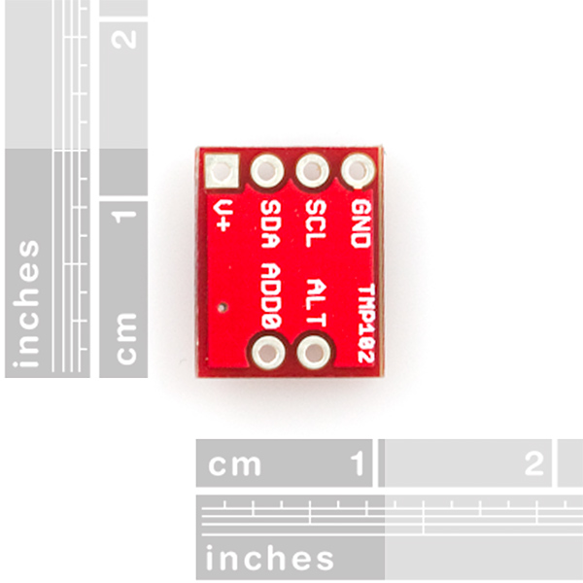
Wiring
https://docs.espressif.com/projects/esp-idf/en/latest/esp32s3/hw-reference/esp32s3/user-guide-devkitc-1.html

Slide 45
https://docs.espressif.com/projects/esp-idf/en/latest/esp32s3/hw-reference/esp32s3/user-guide-devkitc-1.html

Slide 46
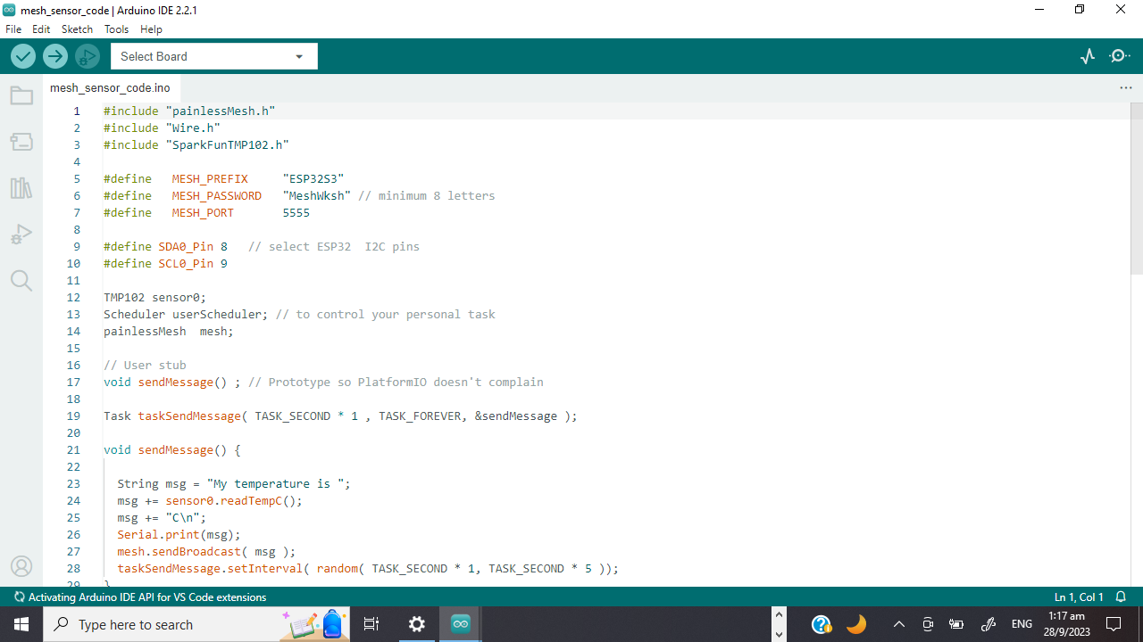

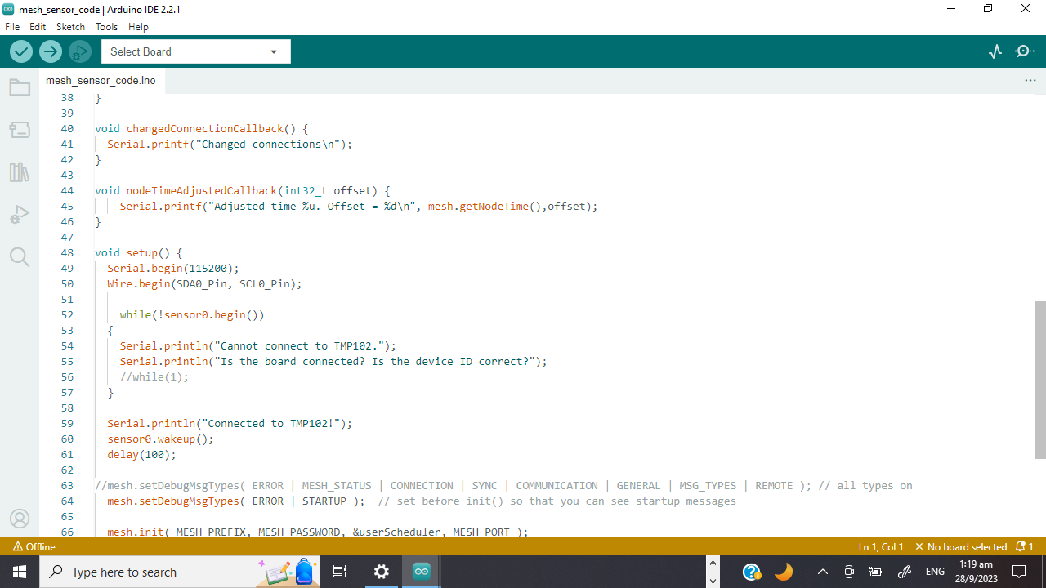
Code Inspection

Slide 47
Let’s Try It Out!
Flash the mesh_sensor_code

Slide 48
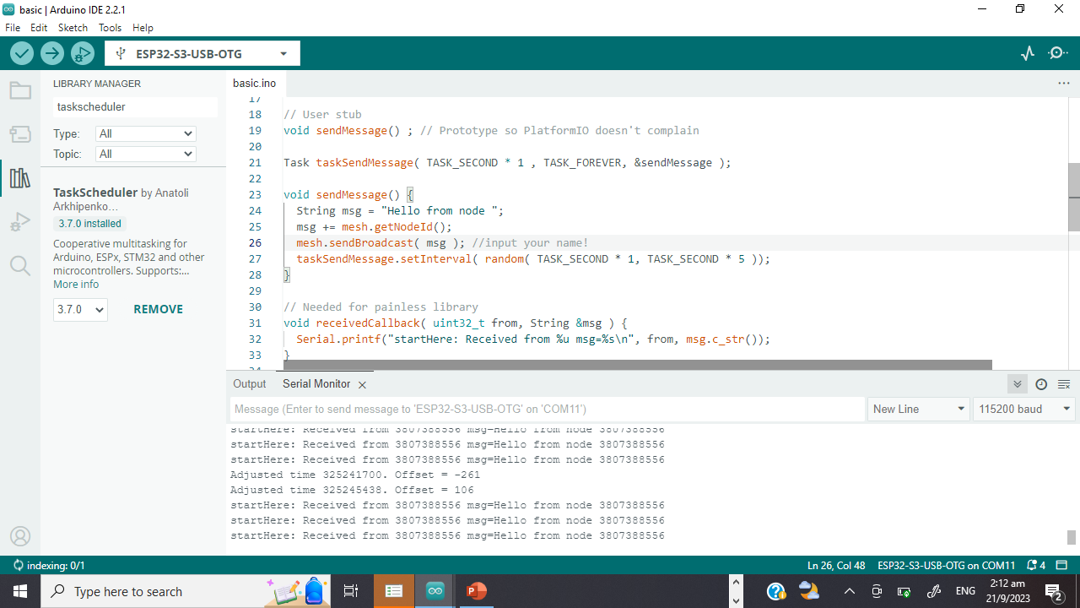
Code Inspection
Read the data from the sensor
Compile data into the message

Slide 49
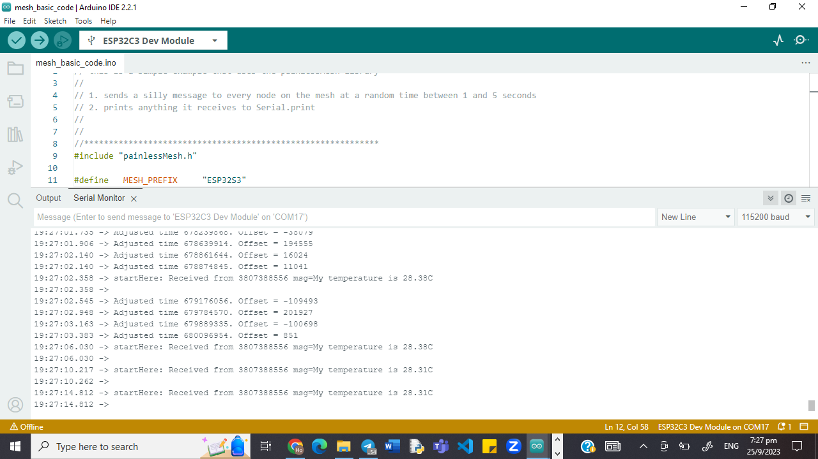
Expected Outcome (Connected)

Slide 50

Potential Projects

Slide 51



THANKS!
Do you have any questions?
e0774750@u.nus.edu
https://www.linkedin.com/in/ho-wei-hao/
Feel free to contact me for hackathon, project etc. collaborations!

